Slide 1

Team ID: 19437
Team Name: Team Avengers
No. of Members: 6
Team Leader Name: Suraksha Rajagopalan
Problem Statement ID: PK854

Slide 2
Details of all Team Members
SN | Team Member Name | Role | College Passing Year
1 | Suraksha Rajagopalan | Team Leader | 2025
2 | Gajji Mohit Yadav | Team Member | 2025
3 | Pranav Krishna U | Team Member | 2025
4 | Rohit Rajesh Nair | Team Member | 2025
5 | Nambiar Krishnendu Radhakrishnan | Team Member | 2025
6 | Lekha Sathvik Devabathini | Team Member | 2025
7

Slide 3
Idea Description (5 to 6 lines)
We used a decision tree classifier for the identification of the disorder dyslexia, In the writing part a picture of the child's handwriting is sent which produces the output whether the child is dyslexic or not. In the speaking part the child's pronunciation skills are being checked, the result is the difference between phonetics pronounced and the original sounding of the word. In the listening part we decided to dictate some words for the child and check how much are the typed words similar to the dictated words.

Slide 4
Innovative Idea Solution (50 Words)
We used a decision tree classifier which has a accuracy of 95% for the identification of the disorder dyslexia, Since dyslexia is a learning disorder we divided the text into 3 parts to check the writing, speaking and listening capability of the child. In the writing part a picture of the child's handwriting is sent, now using computer vision we converted a handwritten text into a computerized text, for which the spelling, context, grammar and phonetics accuracy is checked the output tells whether the child is dyslexic or not. In the speaking part the child's pronunciation skills are being checked, the result is the phonetics pronounced and the original sounding of the word. In the listening part we decided to dictate some words for the child and check how much are the typed words similar to the dictated words.

Slide 5
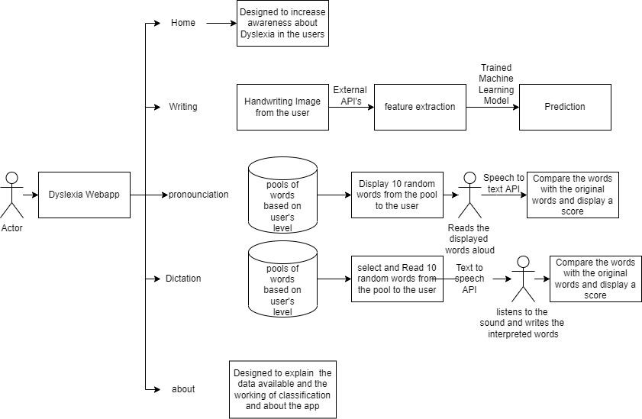
Solution Architecture

Slide 6
Technology Stack
The whole application is developed in Python Language
The frontend of the application is developed using Streamlit
The text processing API’s used are textblob, language_tool_python, Abydos(phonetic analysis), eng_to_ipa(phonetic analysis), azure cognitive services.
For Computer vision Azure cognitive services are used.
Speech_recognition library is used for speech-to-text.
For text to speech pyttsx3 is used.

Slide 7
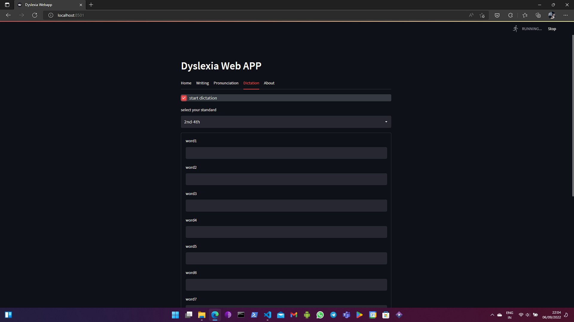
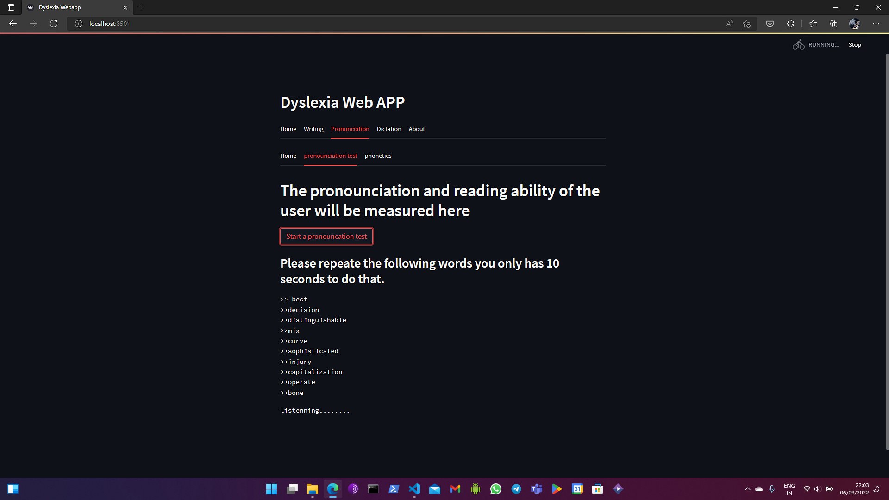
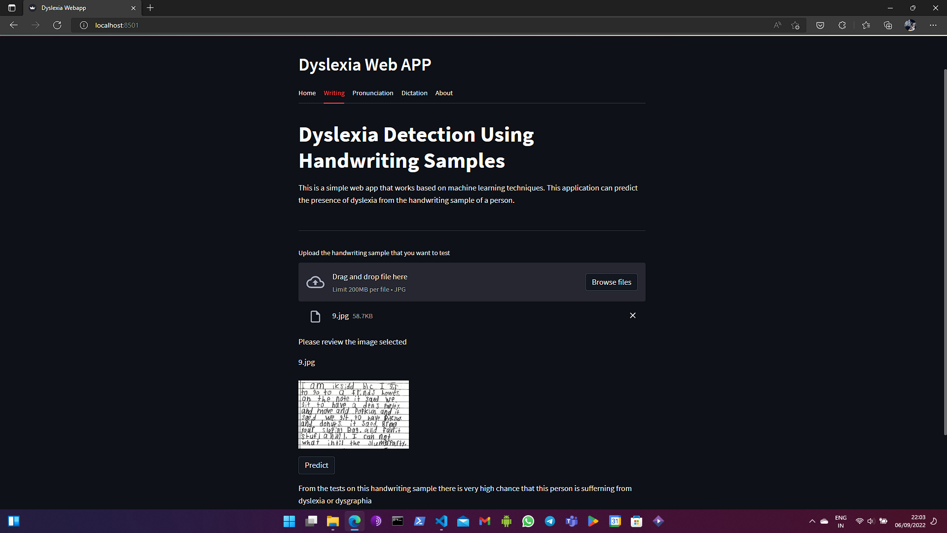
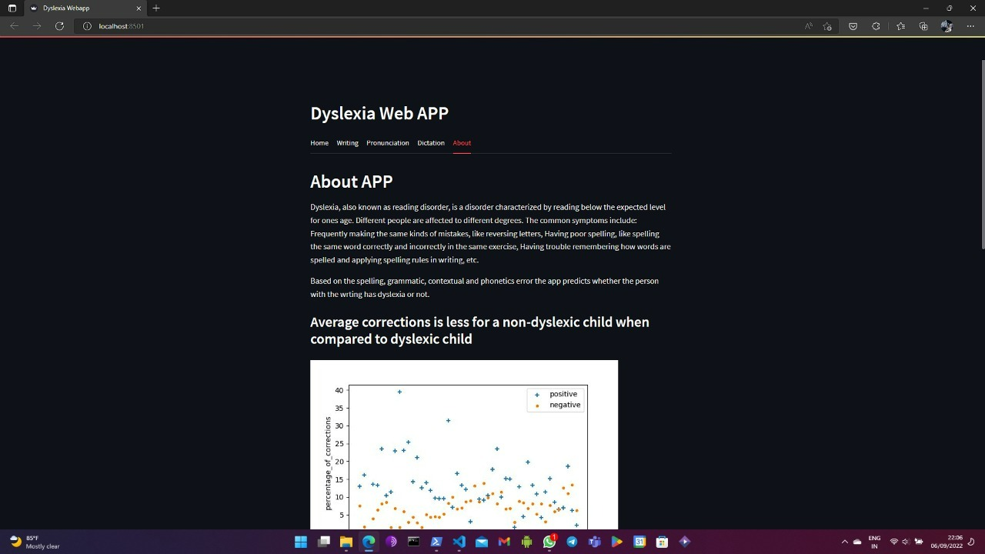
Images / Screenshots of the working prototype

Slide 8
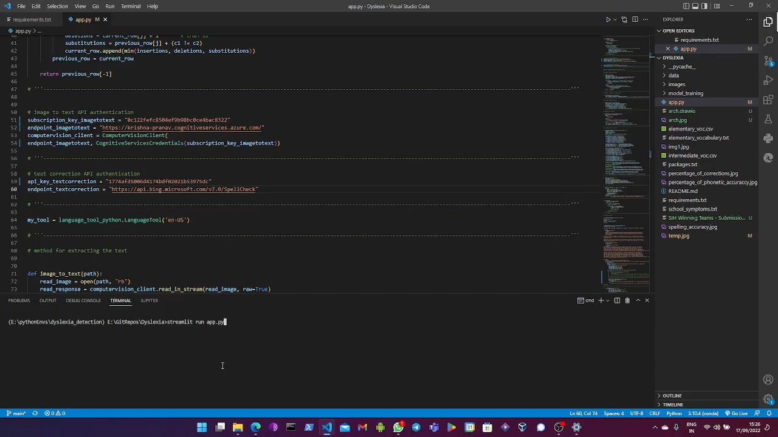
Video of Working Prototype

Slide 9
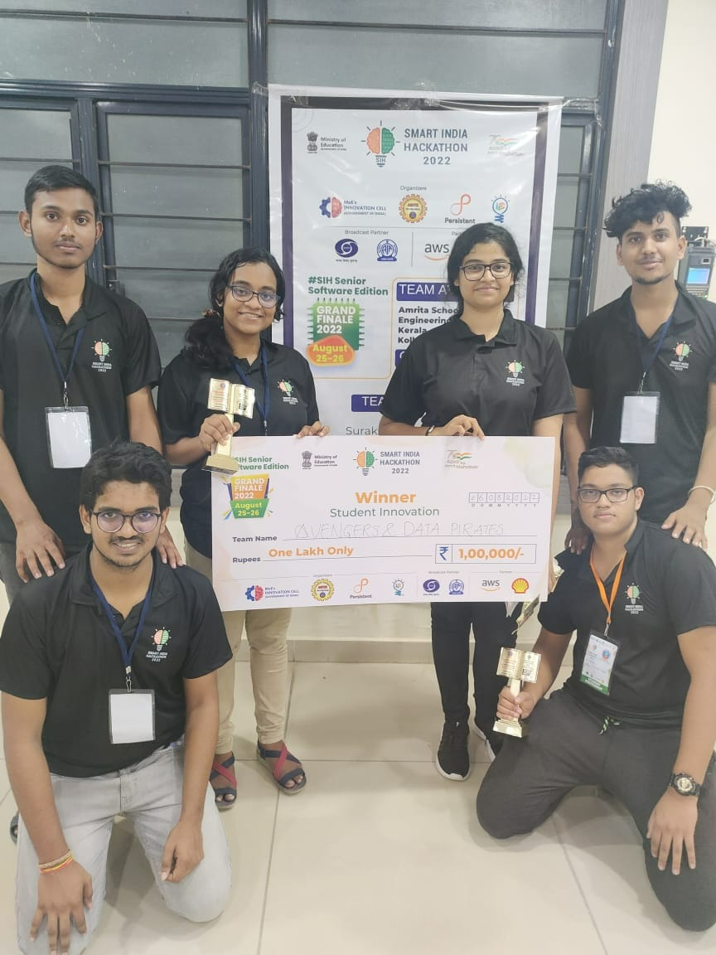
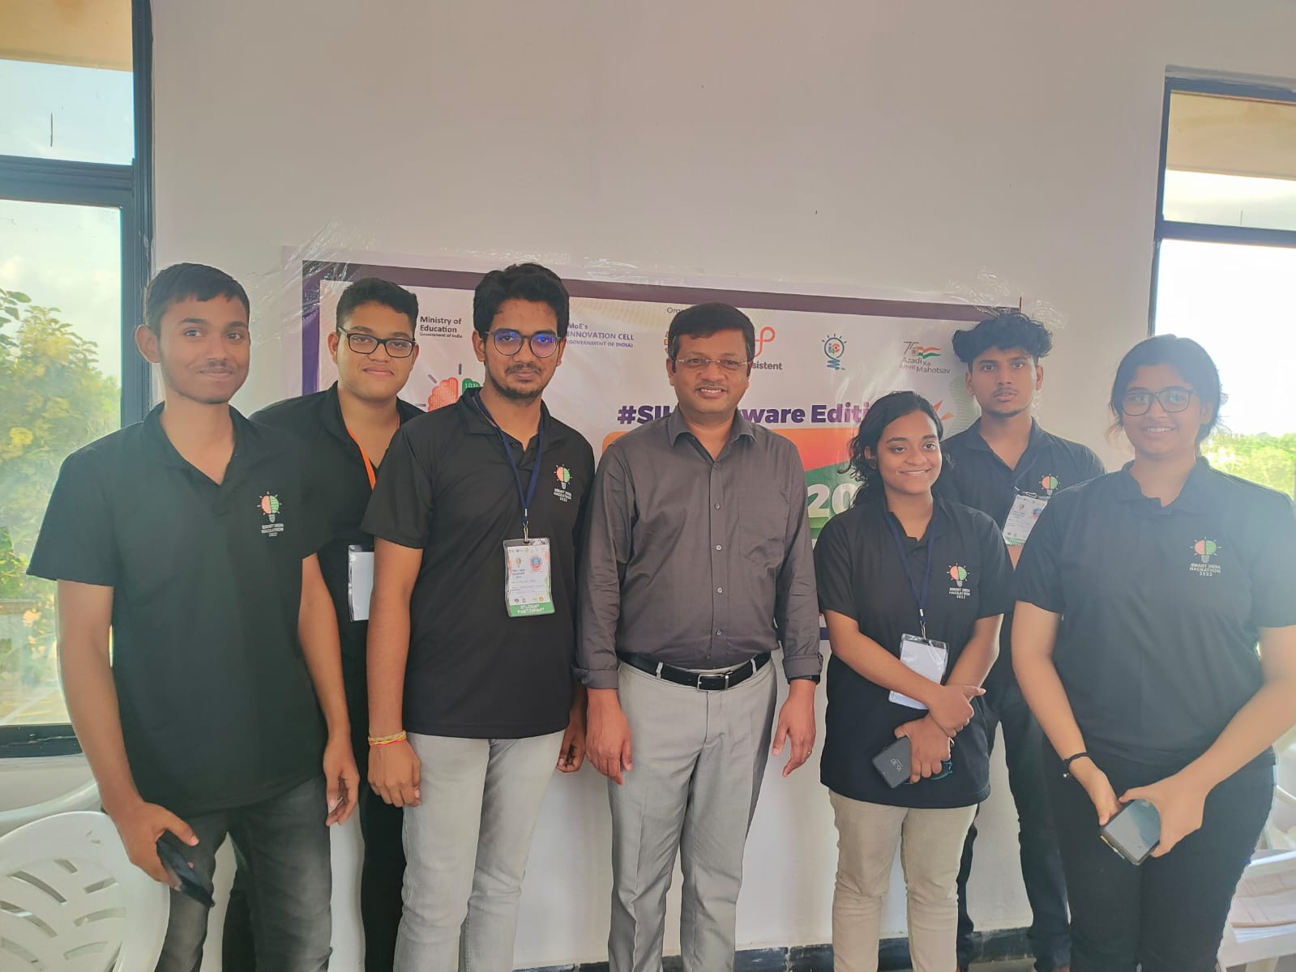
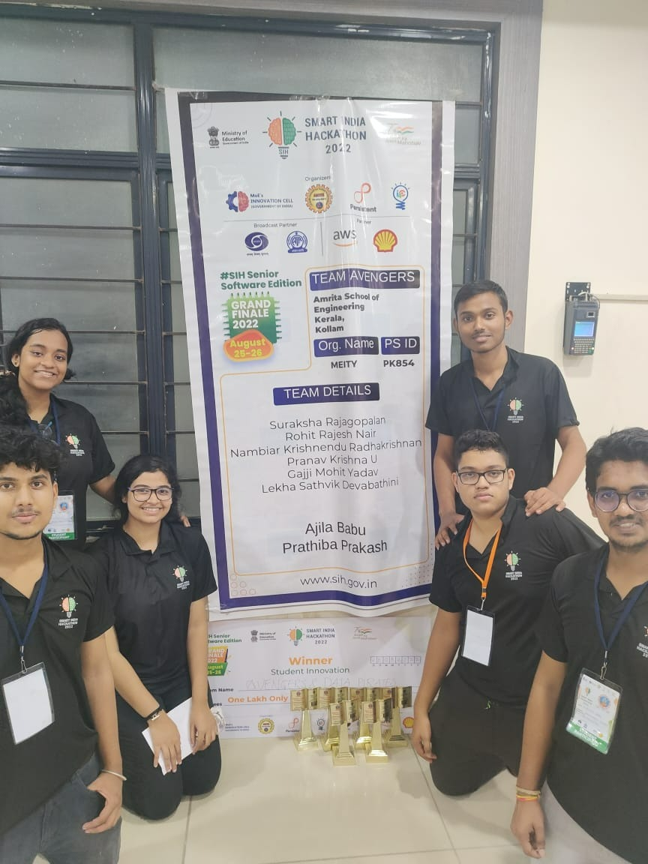
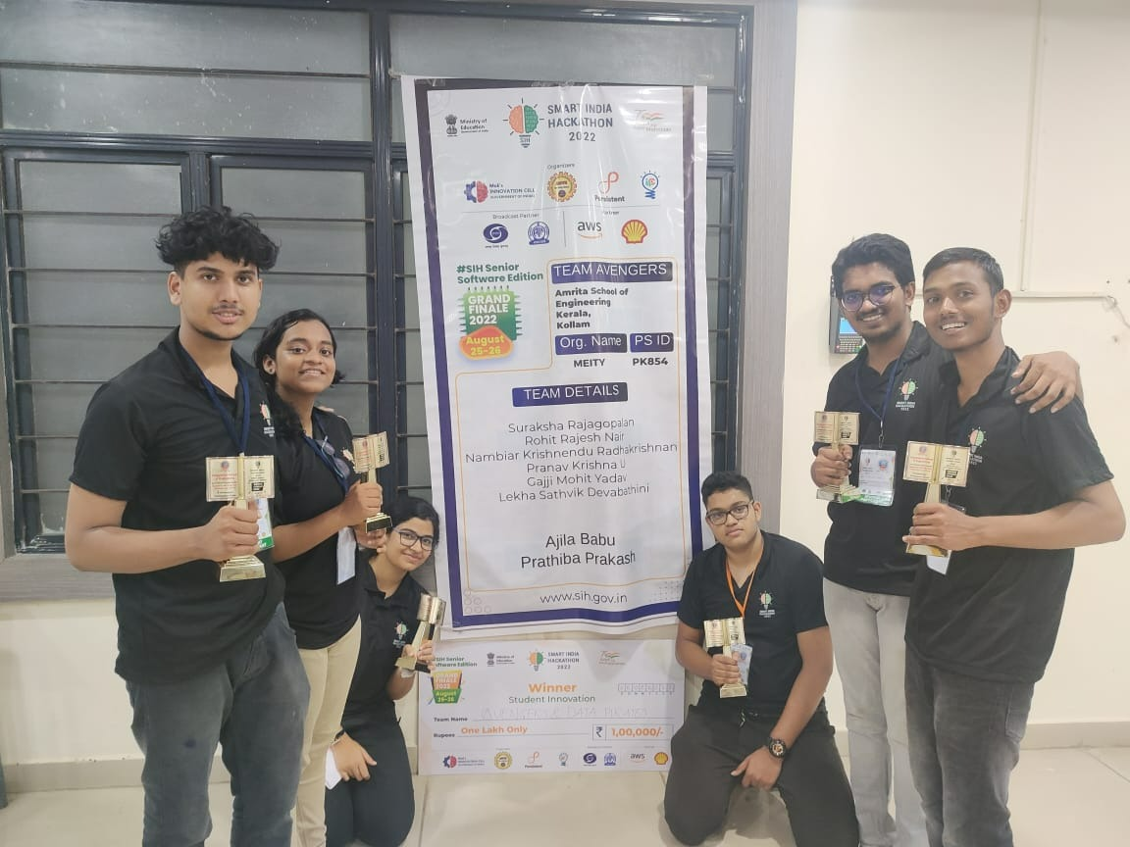
Group Picture of all Participants with Developed Prototype (High Resolution) (If possible in SIH Tee-shirts)

